Slide 1

Introduction to the methods and tools of software engineering

Slide 2
Software engineering - is an area of ​​computer science and technology, which is engaged in the construction of software systems ... This is an engineering discipline that is associated with all aspects of software production (software) from the initial stages of creating a specification to support the system after commissioning. The term - software engineering (software engineering) - was first made public in October 1968 at the NATO conference Subcommittee on Science and Technology (g.Garmish, Germany).
The essence of software engineering methodology is to apply a systematic, scientific and predictable process design, development and maintenance of software.

Slide 3
One of the basic concepts of software engineering is that of the software life cycle and software process. The life cycle of the software - the period that begins with the decision on the need for a software product and ends at the moment of its complete withdrawal from service. This cycle - the process of building and developing software. The life cycle is divided into individual processes. Process is a set of actions and objectives which will achieve significant results.

Slide 4
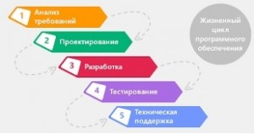

Slide 5
The main processes (sometimes referred to as stages or phases) of the life cycle are:
Development of requirements specification (result - describe the requirements for the program, which are required to perform - a description of what the program should do);
- Development of a project (the result - a description of how the program will work);
- Coding (result - source code and configuration files); - Testing of the program (result - the program requirements for the control);
- documentation (result - the documentation of the program);
- Support (changes in the software to correct errors, increase productivity and adapt to changing conditions work or requirements).

Slide 6
Currently SWBOK community included 15 area of expertise, including
Software Engineering Models and Methods - Models and methods of development.
Knowledge Area "Methods and tools of software engineering (Software Engineering Tools and Methods)" is divided into sections:
Software Engineering Tools;
Software Engineering Methods;
Tools and methods of software engineering.

Slide 7
Methods provide design, implementation and execution of the software. They impose some restrictions on the engineering software in connection with the peculiarities of their application notations and procedures, and provide assessment and validation of processes and products. Tools are software support individual methods of software engineering, and provide automated tasks lifecycle processes.

Slide 8
Methods of software engineering form some action procedures aimed at achieving success in a particular field. Methods usually provide a corresponding notation, Glossary and the procedure of a certain set of tasks, as well as recommendations for assessment and verification of a running process and gets the result in its product. Methods as tools can have a different scale.
CASE (Computer-Aided Software Engineering) - a set of tools and methods for software engineering design software, which helps to ensure the high quality of the programs, the absence of errors and ease of maintenance of software products.

Slide 9
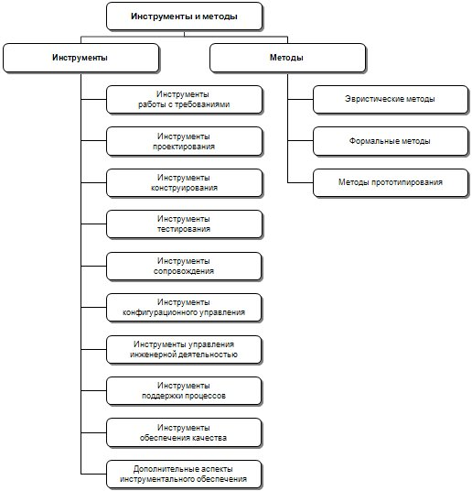
Область знаний “Инструменты и методы программной инженерии”

Slide 10
(Software Requirements Tools)
(Software Requirements Tools) -
Requirement Development Requirement Management – are analysis, collection, and testing requirements specifying.
Software Design Tools are for creating software using the basic notation(SADT/IDEF, UML, Microsoft DSL, Oracle et cet);
Software Construction Tools are production and broadcasting of programs of machine performance.

